Slide 1
Tiling
Removing excess water and minimizing soil erosion

Slide 2
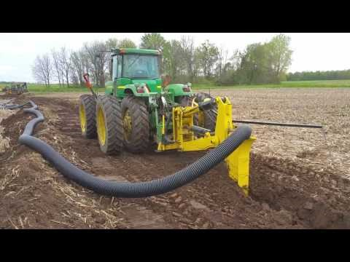
What is the farmer doing?
https://youtu.be/njFvJIulMno

Slide 3
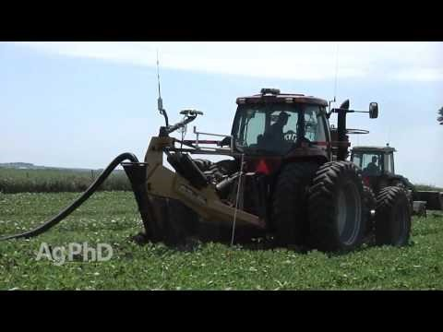
What is tiling?
https://youtu.be/urFyIXKoM-U

Slide 4
Why Tile?
Higher Yields and improved crop quality:
Field drainage improves crop quantity and quality.
Results from over 125 drainage experiments show increases attributed to subsurface drainage: corn by 34%, alfalfa by 42%, soybeans by 29%, and wheat by 76%
Faster Soil Warm-up:
Environmental advantage of a 5-15 degree increase in temperature.
Wet, cold soil is eliminated and surface evaporation is reduced.
Reduced Compaction:
Creates drier soil and reduces the risk of a compaction caused by working wet ground.
Tiled fields stay un-compacted more reliably than non-tiled fields and as a result, produce greater yields.

Slide 5
Why Tile?
Larger, Deeper Roots:
Lowered water table causes root systems to seek deeper moisture and creates air and water channels.
This results in better root growth and soil penetration that allows plants to extract more nutrients for longer.
Better Soil Aeration:
Tile plows create soil that percolates better and allows more air and water to reach the roots.
Ideal soil make up is air – 25%, water – 25%, soil – 50%
Favorable Environment:
Opening the soil with drainage plows creates an optimal environment for beneficial soil microorganisms and earthworms.
Aerobic organisms are vital for plant growth and help make nitrogen and sulfur more accessible.

Slide 6
Why Tile?
Reduced Yield Variation:
Produces a reliable and consistent increase in yield.
University study showed that un-drained soil saw a 46% fluctuation in yield in comparison with tiled soil that only varied by 18%.
Consistent yield allows for dependable cash flow for farmers.
More Days of Machinery Operation:
Accelerated drying and warmer soil allows for earlier spring planting and longer fall operations.
Dry soil limits compaction and facilitates timely post-emergence applications.
Longer Growing Seasons:
Early planting in warm, dry fields gives plants the maximum opportunity to thrive and produces high yields.

Slide 7
Why Tile?
Superior Soil Structure:
Allows field drainage that promotes soil health through soil granulation and root interaction with water and air.
The resultant porous soil retains necessary water for optimal growing.
Increased Dry Year Yield:
Deeper roots enable plants to withstand summer droughts.
Deep roots obtain valuable nutrients before late-summer climate stress.
Reduced Nitrogen Loss:
Creates dry soil that is optimal for nitrogen utilization and thriving aerobic organisms.
Because nitrogen is one of the most expensive inputs, reduced loss allows farmers to save money and produce better crops.

Slide 8
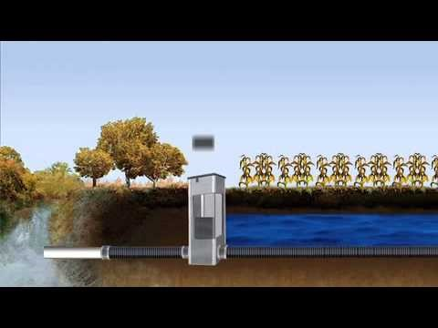
Nutrient loss reduction
https://youtu.be/-Yz2QdO9-Ec

Slide 9
Why Tile?
Consistent Seed Stands:
Reduced incidence of seeds rotting before germination and better stands are achieved because of drier soil.
Toxin Removal:
Tiling cleanses soil.
Toxic substances, disease-causing organisms, and dangerously high levels of iron and manganese are removed through better drainage and improved aeration.
Reduced Erosion:
Enhanced field drainage creates soil that can hold extra rainfall, reducing run-off and allowing absorption.
This erosion-control maintains both fertility level and soil structure.

Slide 10
Why Tile?
Lower Drying Costs:
Tile drainage allows crops to grow and mature faster and reduces the necessary drying time in the fall.
Lower Machinery Costs:
Allows farmers to be in the fields for more days and for longer during the day during the crop season and harvest.
This efficiency advantage allows farmers to do more with less equipment.

